Slide 1
Course Title: PROGRAMMING IN JAVA Course Code: CSE 310
TOPIC: Daily Task ScHeduler
Submitted to : Dr. Ranjith Kumar A
Submitted by
Himanshu yadav 12110311
Deepanshi Bohra 12110402

Slide 2
Contents:
Introduction
Code
Explanation of the code
Output
Future scope
Concluson

Slide 3
Introduction
Brief description about Daily Task Scheduler
It's a task scheduler for routing life for computer/laptop. It's an very simple project in java which help to schedule your weekly tasks in daily basis.
• This project is made using java swing package using Netbeans IDE. Netbeans IDE.
• User can organise and keep track of daily tasks in one application
Comprehensive task management notification scheduling

Slide 4
Key points
This Java application was created using Intelli J .
Additional library was added for the support of JDBC (Required to setup the connection between the Database and Java Application).
It diversifies 4 different kinds of classes which works together to create a better user experience .

Slide 5
classes
Homepage class
Preferences class
Settings class
Database organisation class

Slide 6
Snapshots of the code

Slide 7
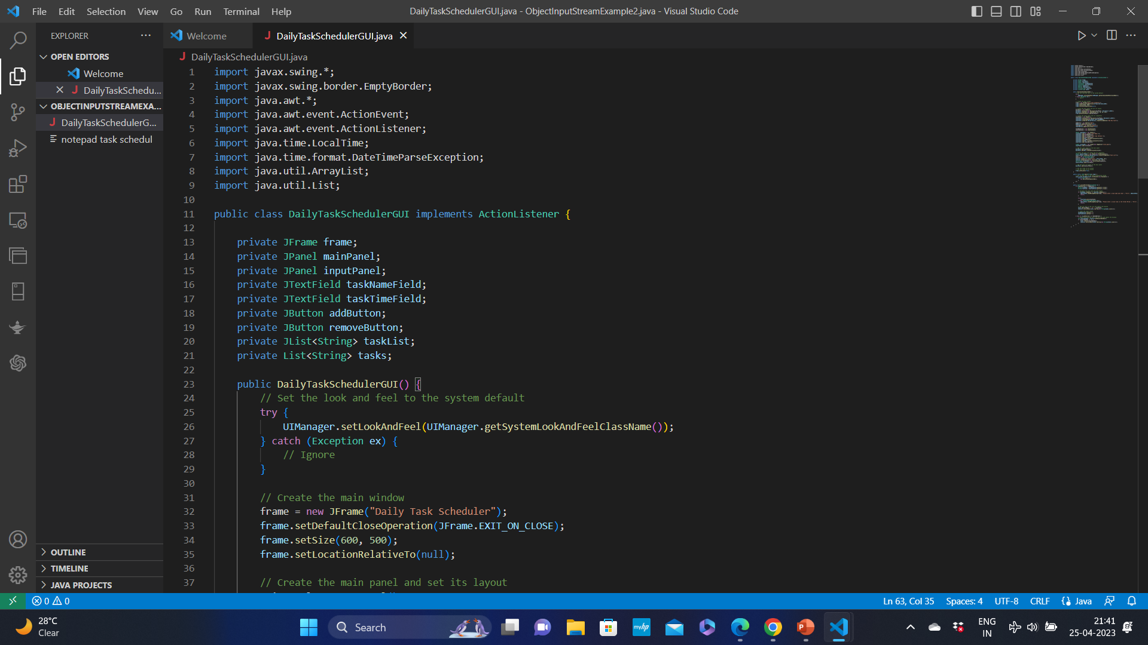
Code of the project

Slide 8
CreatE the main panel
and set its layout

Slide 9
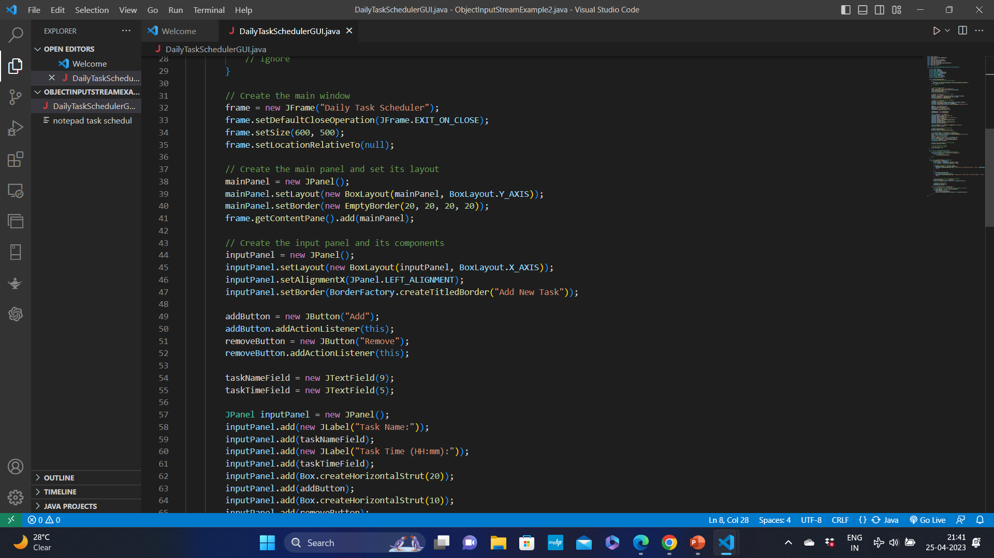
Create the main panel and set its layout

Slide 10
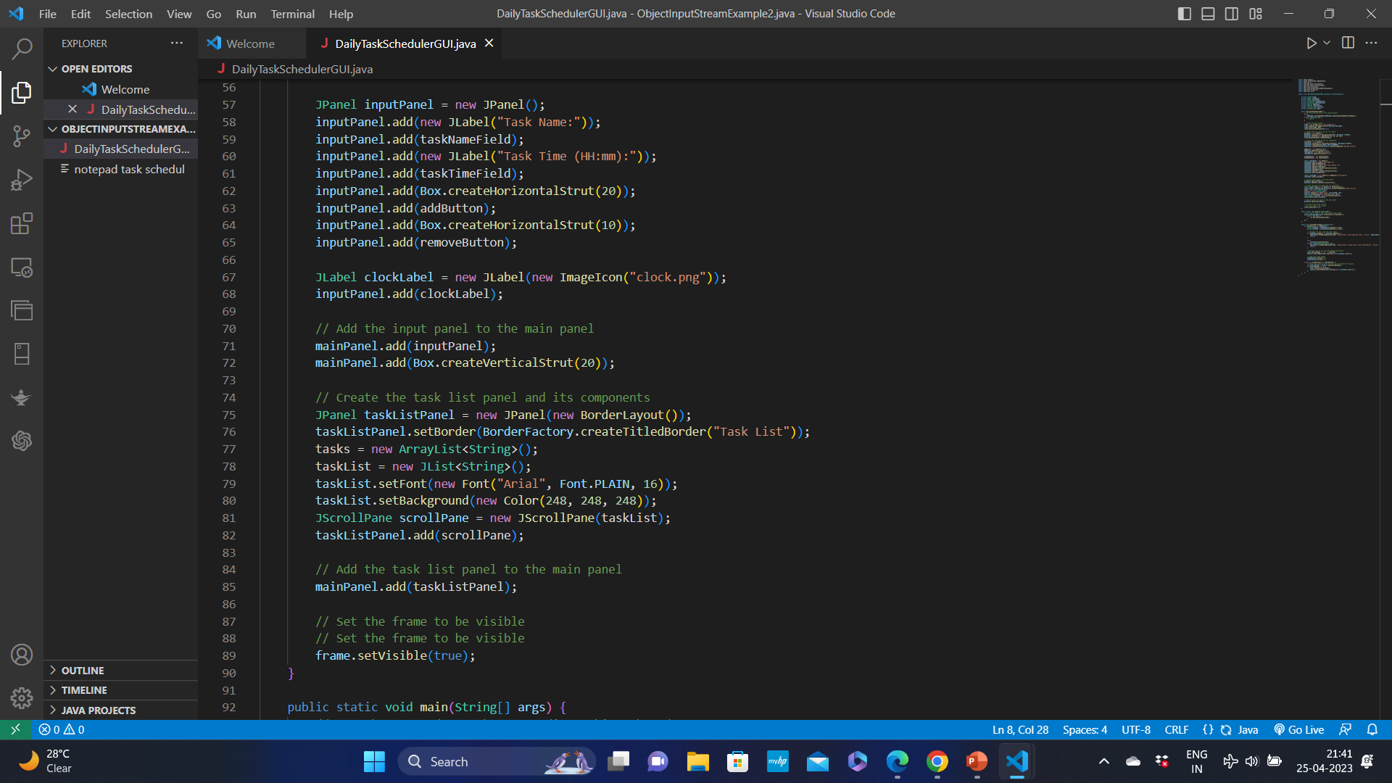
code

Slide 11
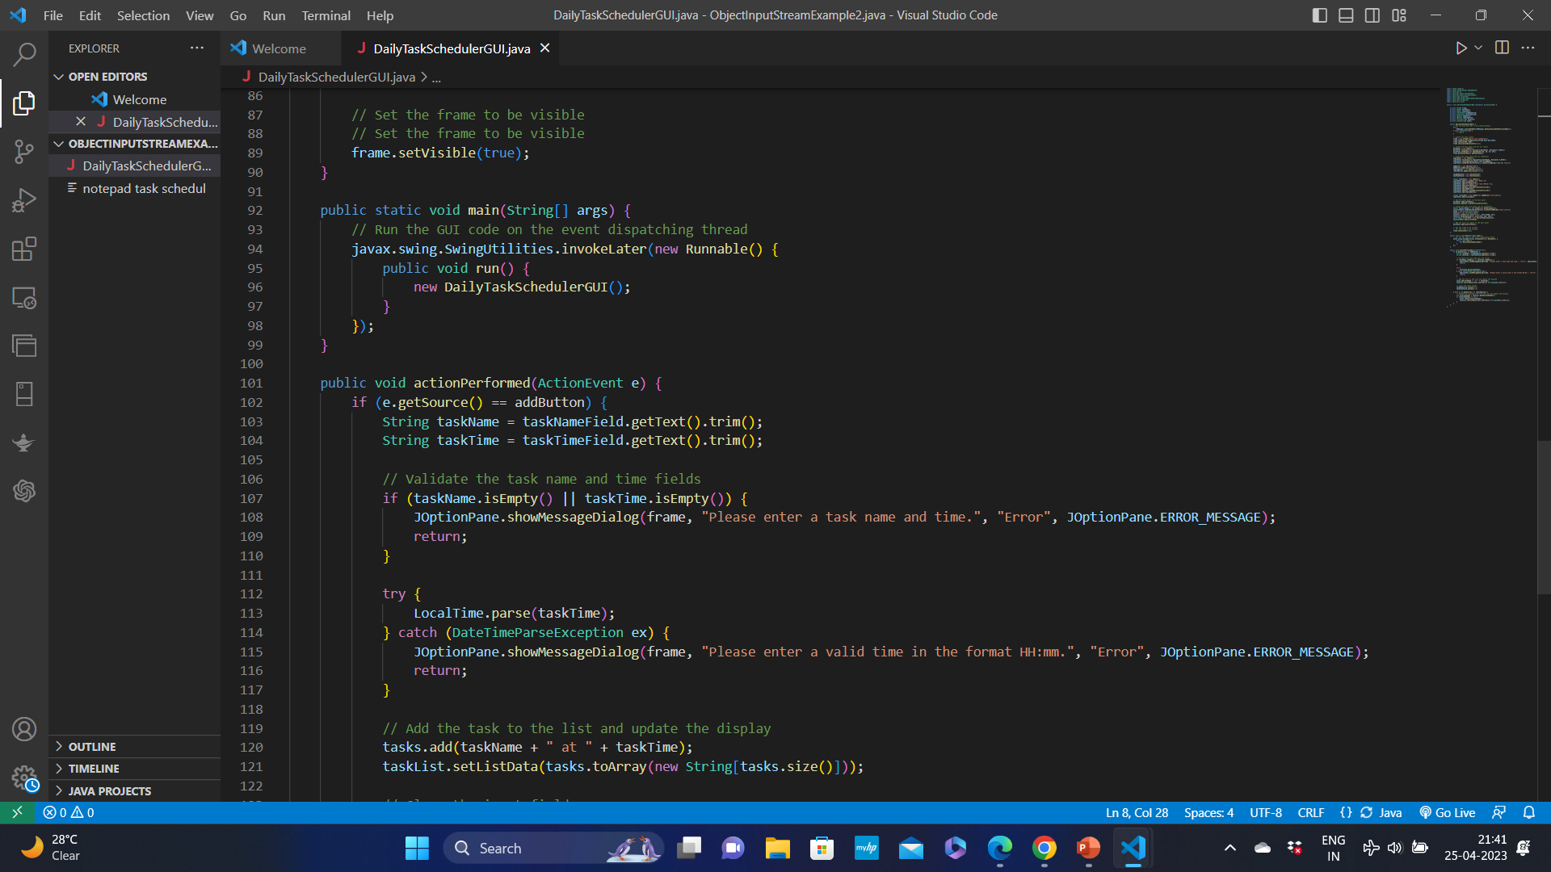
Setting the frame to be visible

Slide 12
Output OF THE CODE

Slide 13
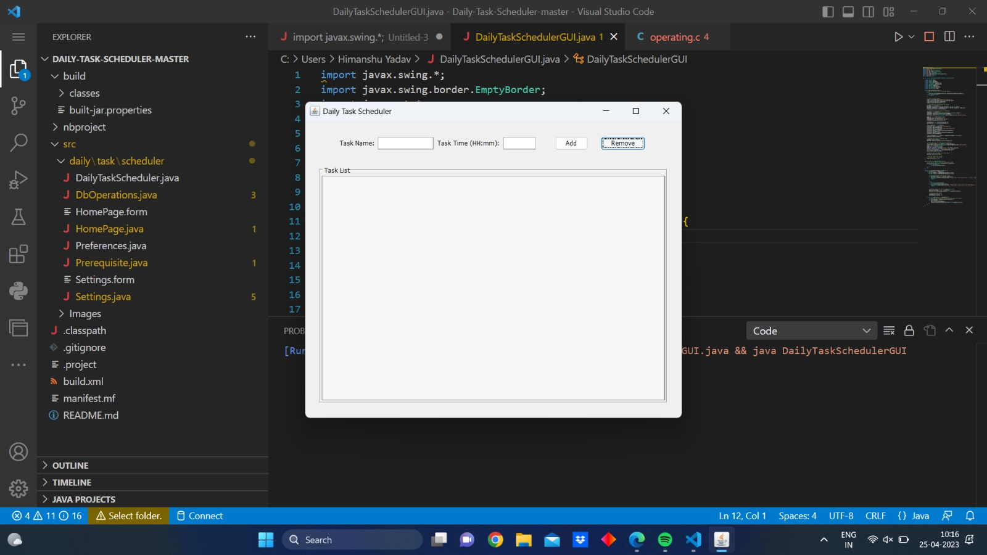

Slide 14
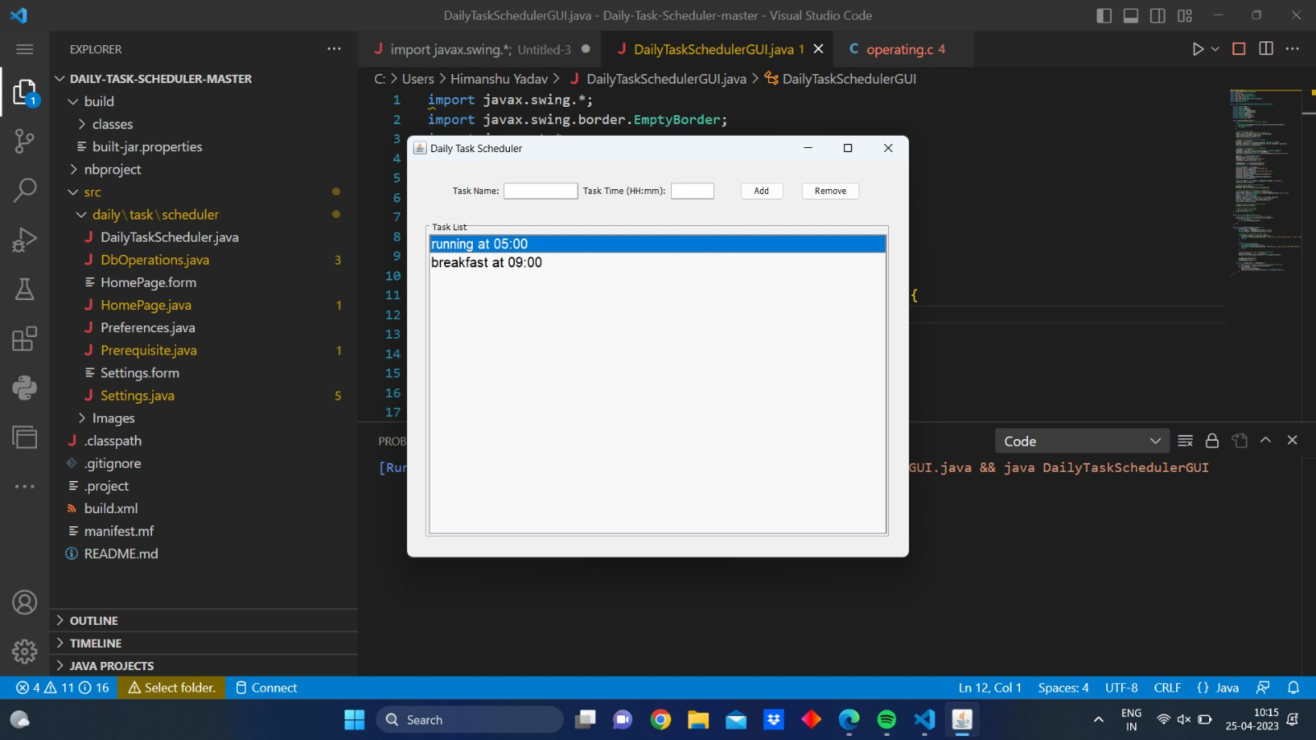

Slide 15
Applications of Daily task scheduler:
System maintenance: This helps ensure that your system is always up-to-date, clean, and optimized for maximum performance.
Task schedulers :are software programs that allow you to automate and schedule various tasks on your computer or server. They are widely used in many industries and for a variety of purposes.

Slide 16
Explanation of the code
This code is an implementation of a simple Daily Task Scheduler graphical user interface (GUI) using Java Swing. Here are the key points:
The code imports necessary Swing classes for building the GUI, and also imports classes for handling events and working with time data.
The class “Daily Task Scheduler GUI” is defined which implements the “action listener” interface to handle events triggered by buttons.
The Gui consists of a main panel (“j panel”) and main window (“j frame”) which is set to have a vertical box layout and a border with empty padding.
Input j panel is created having horizontal box layout , and its components include two text fields for inputting task names and times and two buttons for adding and removing task.
When the add button is clicked the “ action performed” method is called which extracts the task names and time from the task fields and add task to the list.

Slide 17
When the user clicked on the remove button the “ action performed” method is
called which removes the selected task.
Creates a task list panel with a “Jlist” and the task list panel to the main panel.
Sets the GUI frame to be visible.
Implements the main method scroll(” pane.Adds”)to create and run a DailyTaskSchedulerGUI object on the event dispatching thread.
Implements the actionPerformed method to handle button clicks.Validates user input for task name and time fields.
Adds the task to the list and updates the display when the "Add" button is clicked.
Removes the selected task from the list and updates the display when the "Remove" button is clicked.

Slide 18
Future Scopes
Automation: Task schedulers will become more automated, allowing users to delegate tasks to the software, which will then allocate resources, assign priorities, and set deadlines automatically.
Integration with Artificial Intelligence: Task schedulers will be integrated with AI to provide intelligent suggestions for task allocation, prioritization, and scheduling. This will enhance efficiency and save time for users.
Personalization: Task schedulers will allow users to customize their preferences and workflows, enabling them to work in a way that suits their individual needs.

Slide 19
Conclusion
In general, concluding a project task scheduler would involve reviewing the tasks that were planned, evaluating whether they were completed on time and within budget, and identifying any issues or challenges that arose during the project.
Based on this evaluation, you could develop recommendations for improving future project task scheduling, such as adjusting the timeline or assigning additional resources to certain tasks. You might also identify best practices that worked well and should be continued in future projects.
Ultimately, the conclusion of a project task scheduler should provide a clear summary of the project's performance, as well as insights and recommendations that can be applied to future projects.

